Slide 1
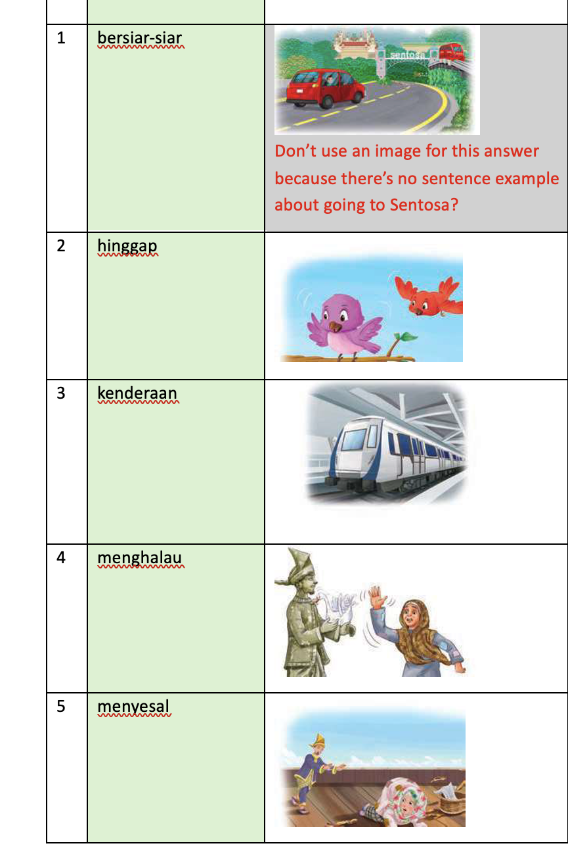

Slide 2
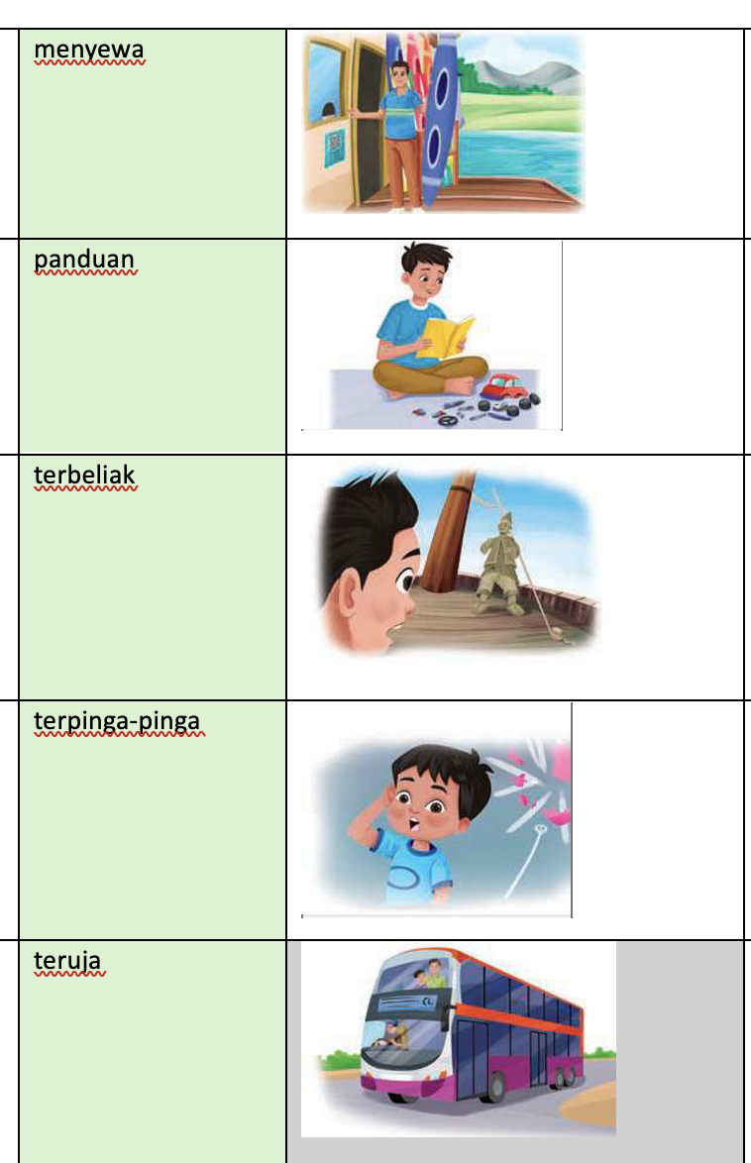
draw in a few dollar notes in the father’s hand (stack of notes)
write the word Panduan on the book cover
To include a question mark above the boy’s head.

